Slide 1
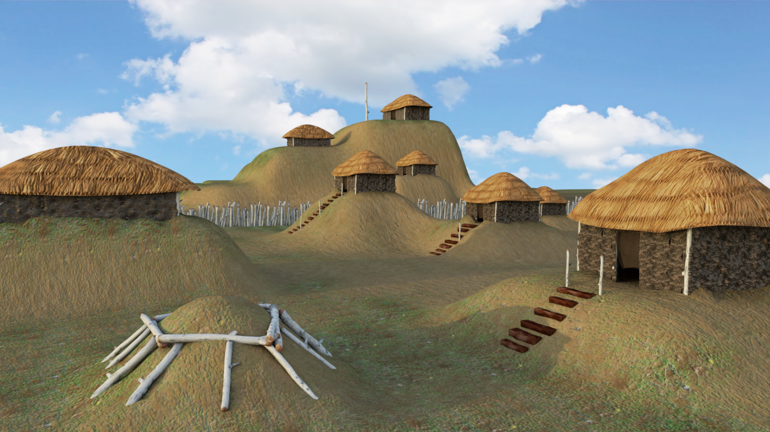

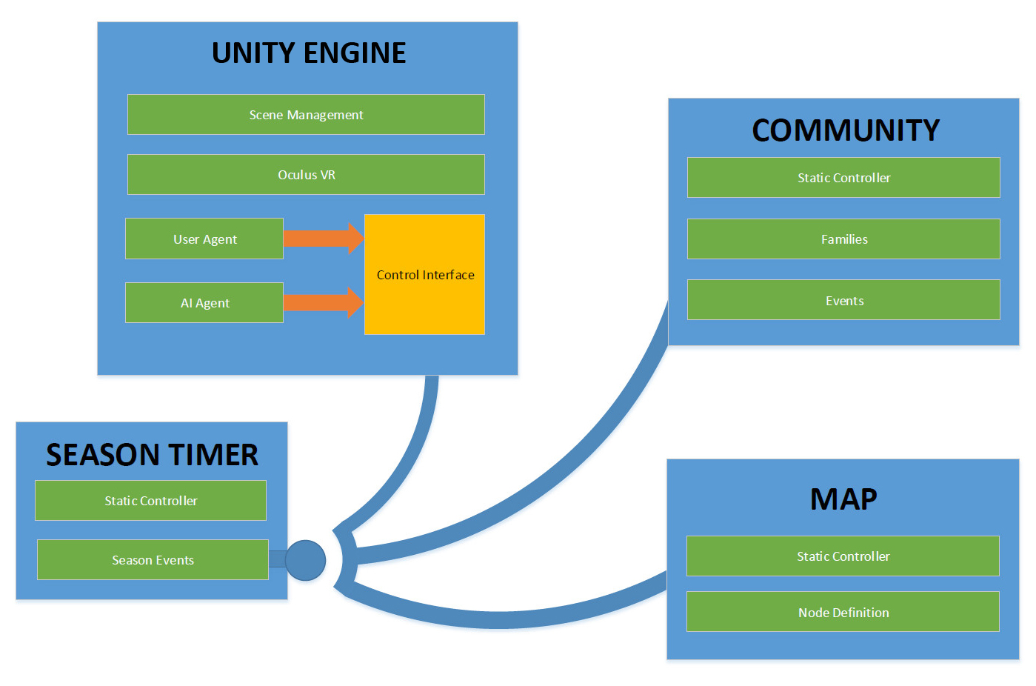
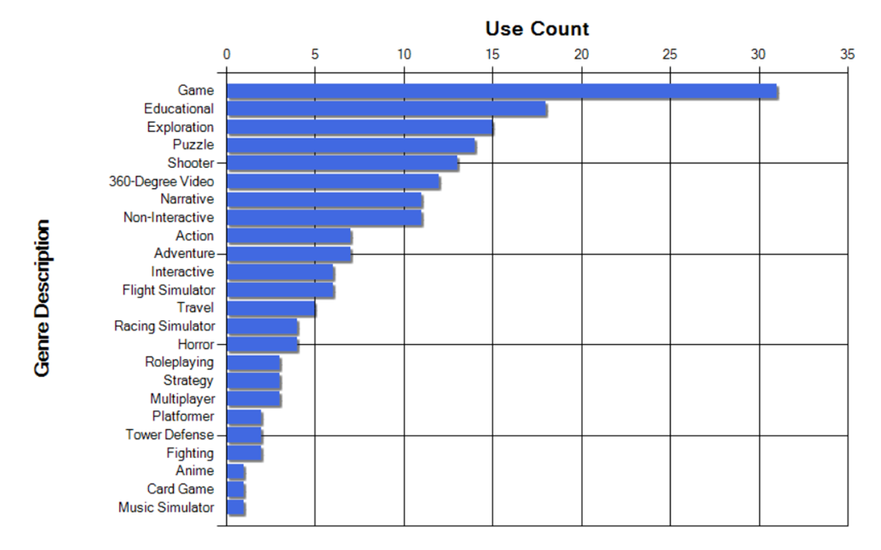
VR Application Research & Design
Daniel Johnson | Asad Ashur | T. Avery Eich -- Department of Computer Science
Dr. Aleshia Hayes, Advisor
RESEARCH
DESIGN
PROTOTYPE
Basis & Direction
Genre & Mechanics
Since Virtual Reality technology and tools became accessible to small teams of engineers and artists, teams now produce immersive experiences without the need to adopt implementation techniques beyond those of traditional video game design. In light of these advancements, this project aimed to first perform research on current VR content, and utilize that research to design a unique VR experience.
The team chose to utilize the following four genres in designing an experience: Educational, Simulation, Strategy, and Game. These genres were well-placed for the VR platform, and also provided a synergy between the following mechanics: 360-degree View, Item Use, Static User Interface, and Spatial Awareness.
The mixture of these genres and mechanics was used as a basis for the design of a real-time strategy, cultural simulation experience based in the Mississippian time period (“Mound Builders”).
Method
In order to analyze and visualize data on current VR trends, existing applications were reviewed and findings collected into a relational database using a custom-built desktop application. This application provided basic data entry and reporting features to properly organize and present information.
Results
The results effectively determined genres and mechanics that trended to succeed on the VR platform. Analysis also determined what key genres and mechanics might be combined with the goal of providing a more robust VR experience.
Architecture
Conclusion / Future works
Oculus supports all commercial VR platforms with its robust features. Our project offers modified experiences based on the platform which are easily built for thanks to both Unity and Oculus. Designing the scenarios and simulation required a broad and adaptable feature set, which determines elements of play we can include. The performance issues were most directly affected by graphical rather than procedural considerations, while actual gameplay was limited by creative development of worthy GUI structures. Perhaps the greatest common element of games' themes are their interfaces.
The application architecture followed a simple modular design, allowing the game engine components to respond to global seasonal events.
“Genres used among VR applications.”
(Other data sets related these genres to mechanics.)

